Slide 1

MUSE - Machine enhanced User Sound Experience
Shivam Arora, Aman Soni, Zubair Qazi, Sidharth
Image taken from https://ampedstudio.com/ai-in-music/
Department of CSE, University of Michigan, Ann Arbor

Slide 2
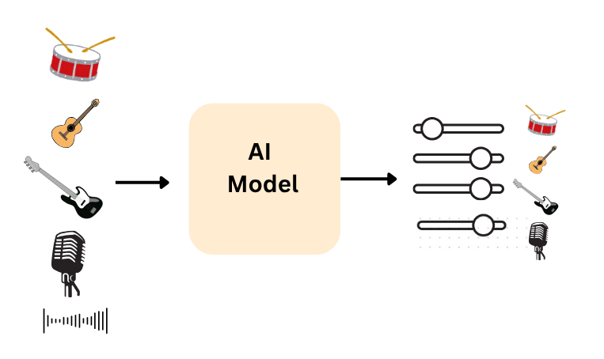
Recap
Design a personalized AI music mixing software to personalize music to users

Slide 3

Functional Requirements
Upload audio files (e.g., MP3, WAV) from the user’s device
Separate audio into components — vocals, instrumentals, background layers
Adjust individual track levels through the chosen interface (sliders, knobs, etc.)
Provide real-time preview of adjustments before exporting
Save the setting for future use
Notes:
Data Handling
"First, we must Upload Audio Files (like MP3, WAV) from the user's device. And critically, the system must Separate audio into components—the individual stems—before mixing can occur."
Mixing & Control
"Next, the user needs to Adjust individual track levels through the interface, such as sliders. This gives the AI—and the user—direct control."
Gesture with hands like you're turning a knob.
Real-Time
"The most challenging requirement is providing a real-time preview of adjustments before exporting. Low latency is key; the user must hear the change instantly."
Persistence
"Finally, for personalization to be meaningful, the system must Save the setting for future use, allowing profiles to be applied to new songs."
"But a powerful tool must also be easy to use. That brings us to the User Experience."

Slide 4
UX Requirements
The interface should be simple and intuitive for users with little or no audio-editing experience.
Provide immediate visual and auditory feedback when adjustments are made.
Enable smooth, low-latency interaction for real-time control.
Maintain a clean, uncluttered layout that highlights main controls.
Support users with different hearing or visual needs through clear visuals and contrast options.
Notes:
Simplicity
"The interface must be simple and intuitive. We maintained a clean, uncluttered layout that highlights only the main controls."
Responsiveness
"We must Provide immediate visual and auditory feedback when adjustments are made. This confirms the system is responding. And the interaction must be smooth, low-latency for real-time control."
Accessibility
"Finally, we focus on accessibility: we need to Support users with different hearing needs through clear visuals and contrast options."

Slide 5
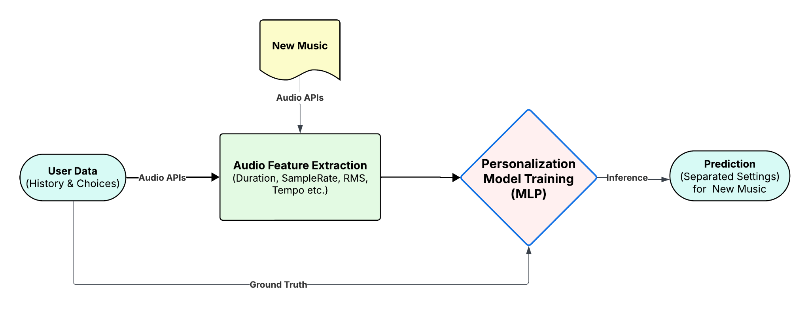
User Personalization
Notes:
1. Introduction: The Personalization Pipeline
"This slide illustrates the technical pipeline for User Personalization—how our AI actually learns a user's taste and predicts the best mix for a brand-new song."
2. The Input Data
"The personalization relies on two main inputs feeding the system:"
User Data (History & Choices): "On the left, we have User Data. This is crucial: it captures the user's past choices and mix adjustments—the Ground Truth—that the model uses to learn their preference patterns."
New Music: "The system is processing New Music, which is the track we need to personalize."
3. Feature Extraction
"The new music first goes through Audio Feature Extraction."
"Here, we use Audio APIs to pull relevant musical features, such as the Duration, SampleRate, RMS (Root Mean Square), and Tempo of the track."
"These features represent the objective characteristics of the new song that the AI needs to analyze."
4. The Model Training and Inference
"The extracted features and the user's historical data converge at the Personalization Model Training (MLP)."
"The model is typically a Multi-Layer Perceptron (MLP), which takes the audio features and the user's learned preferences (from the Ground Truth feedback loop) to make a prediction."
"Once trained, the model performs Inference on the new music."
5. The Prediction
"The final output is the Prediction for the New Music."
"This prediction is a set of separated settings—the optimal fader levels (loudness) for the vocals, drums, bass, and other stems for that specific song, tailored to that specific user."
"This output then feeds back into the mixing engine (as shown in our Recap slide) to create the final personalized audio."

Slide 6

Prototype

Slide 7
Updates
Model integration ✅
Light and dark themes ✅
Finalize audio channels ✅
  Vocal, drums, bass, others
User-specific history + recommendations ✅
Make AIs role explicit ✅
Real-time Mixing ✅

Slide 8
Research Questions
Do users feel the sliders give them adequate, immediate control over the mix?
Does the AI-suggested gain preset feel appropriate and trustworthy? Would explanations or feedback increase users’ willingness to accept the suggestion?
Over multiple saved mixes, do users perceive the model’s recommendations as improving and reflecting their taste?
When mixing fails, do users understand what happened and how to recover (e.g., retry, re-upload, adjust file)?
How do users split time between manual mixing and accepting AI presets? When do users switch between the two?
Are progress indicators and status messages (separation, saving, applying settings) sufficient to keep users oriented?
Do users understand that their personalized model and mixes live locally (per browser)? Does that affect perceived value or trust?
How do users rate mixed output quality across genres?
Over repeated sessions, does reliance on the AI suggestions increase, decrease, or stay stable?

Slide 9
Qualitative Feedback
Human–AI Workflow
  Users see AI presets as a starting point, not the final mix.
  They want strong control features (undo/reset, A/B compare, snapshots) to manage the handoff and quickly converge on a preferred mix.
  UI is simple enough that users are comfortable using it without AI as well.
Control & Responsiveness
  Slider responsiveness is generally satisfactory.
  The vertical slider layout (from Stage 2) works well; no strong complaints or further suggestions.
Trust & Genre Sensitivity
  Trust in AI suggestions is genre-dependent.
  Users want explanations, “why” cues, or confidence indicators to know when to rely on AI vs manual adjustment.

Slide 10
Qualitative Feedback (Contd..)
Personalization
  Personalization clearly improves mix quality once enough history is available.
  Early behavior feels random; users would rather have no AI suggestion than poor initial recommendations.
Data Handling & Privacy
  Local-only personalization increases privacy trust.
  However, it sets the expectation that preferences will not sync across devices.
Audio Quality Limits
  Mix quality is strong for clean, conventional recordings.
  Performance degrades for highly complex tracks (e.g., some Indian pop with dense electronic layers), though overall satisfaction remained high for most test inputs.

Slide 11
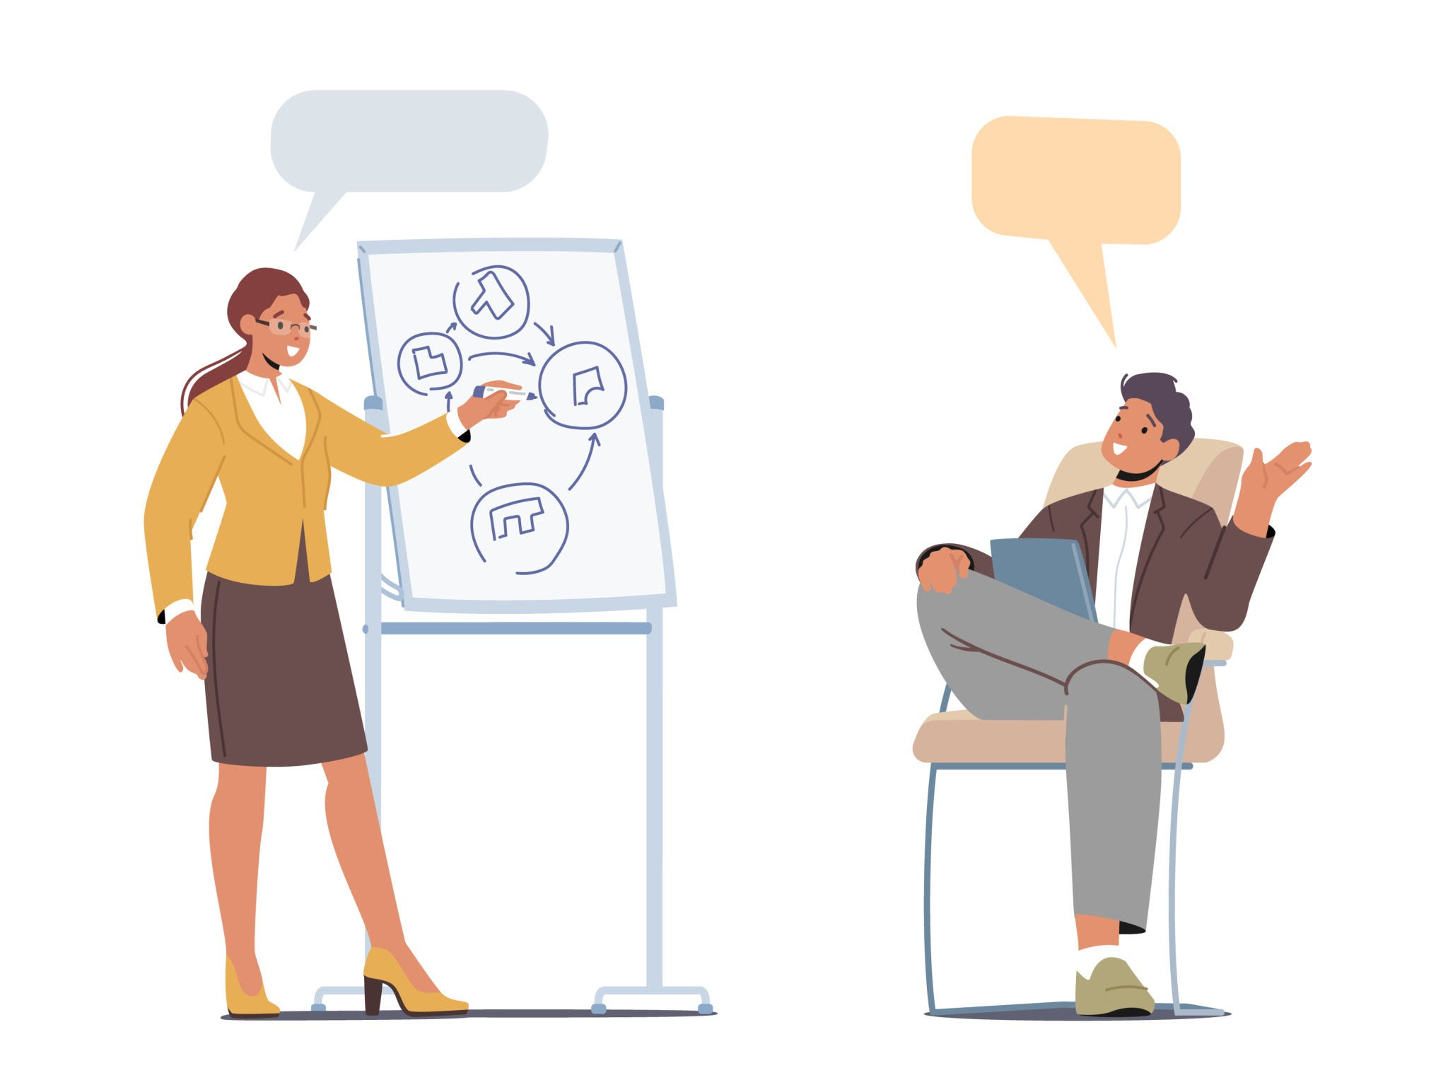

Reflections & Future Roadmap
Key Learnings:
AI as a "Launchpad," Not a Destination
The "Cold Start" Barrier
Privacy vs. Continuity
Future Directions:
Live Hosting
  Web URL
  Cloud Architecture/Cross Device
Genre-Based Averages for new users
Enhanced Control Suite
Login system for different users (Privacy++)
In-depth help page + tutorial

